Slide 1
Set 5

Slide 2
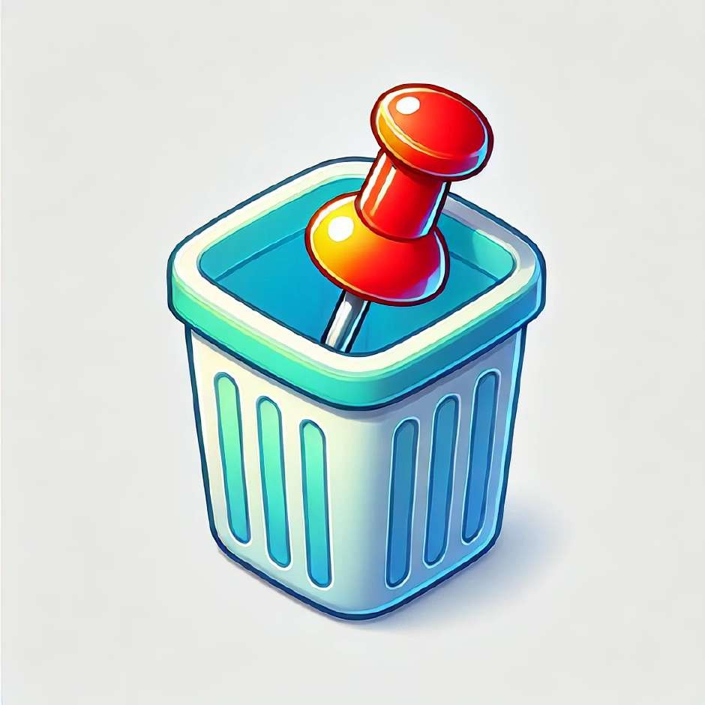
The pin is in the bin.

Slide 3
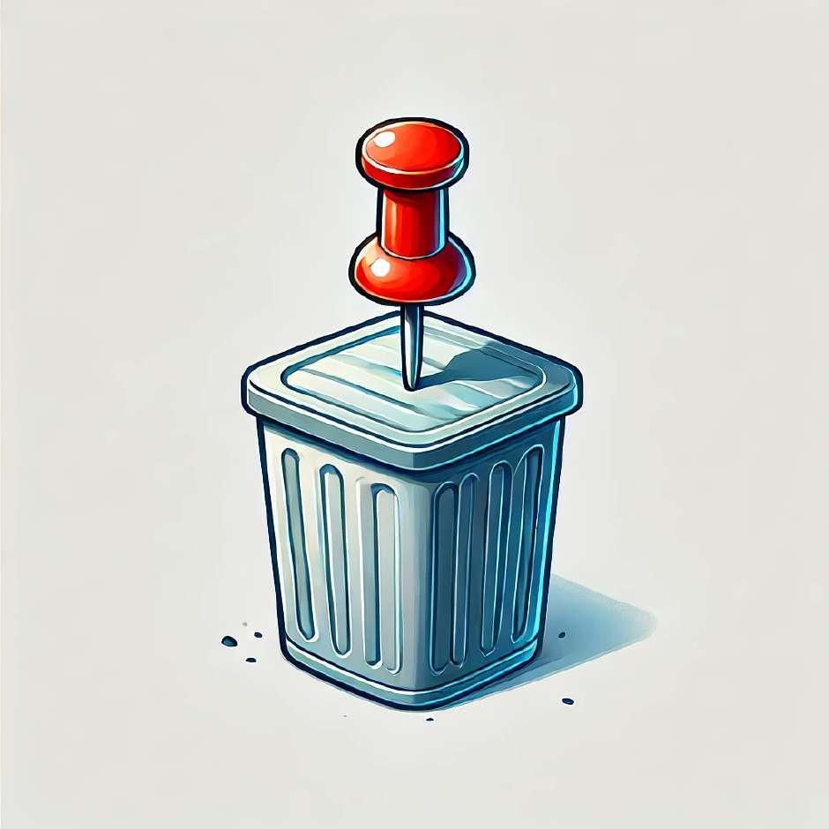
The pin is on.

Slide 4
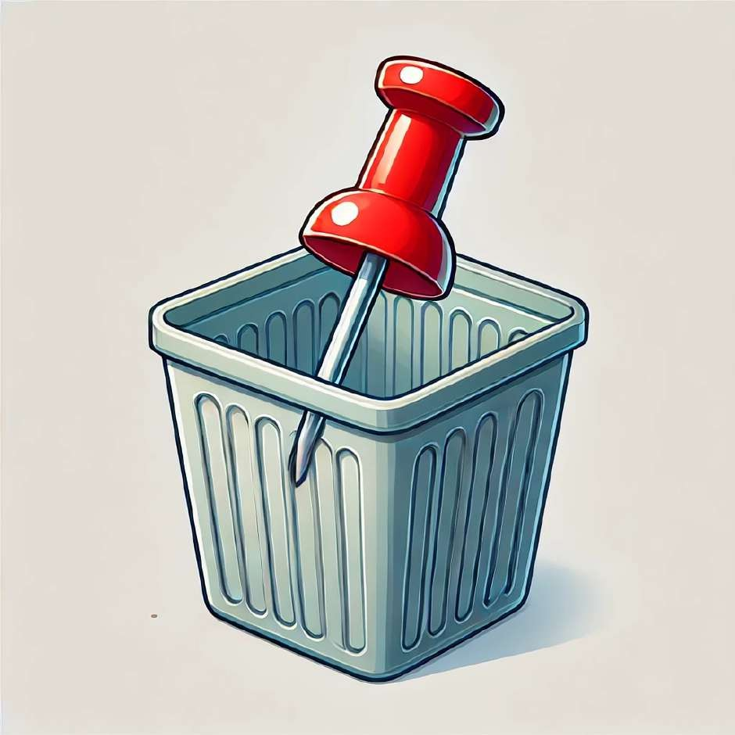
The pin is in.

Slide 5
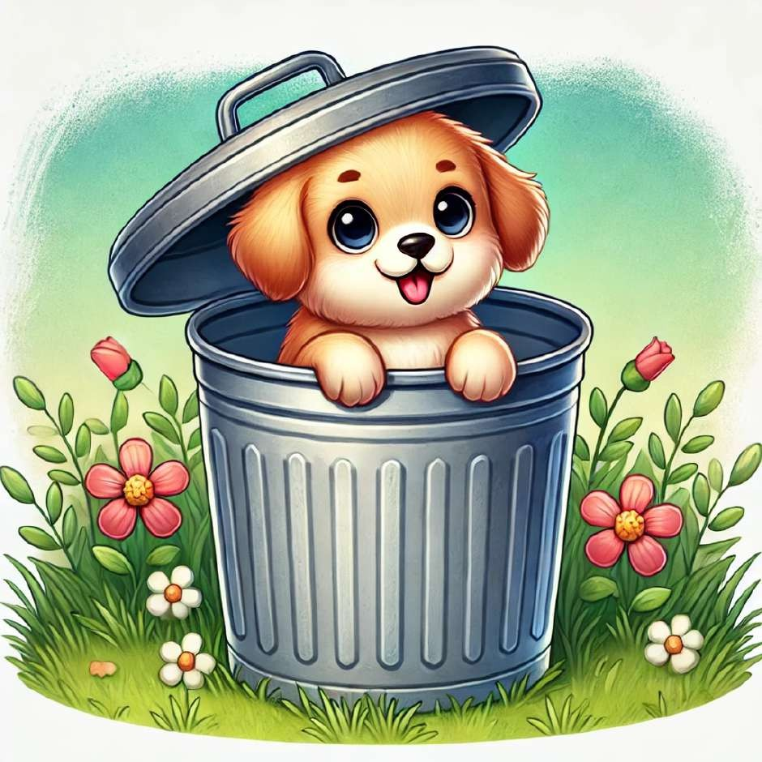
The pet is in the bin.

Slide 6
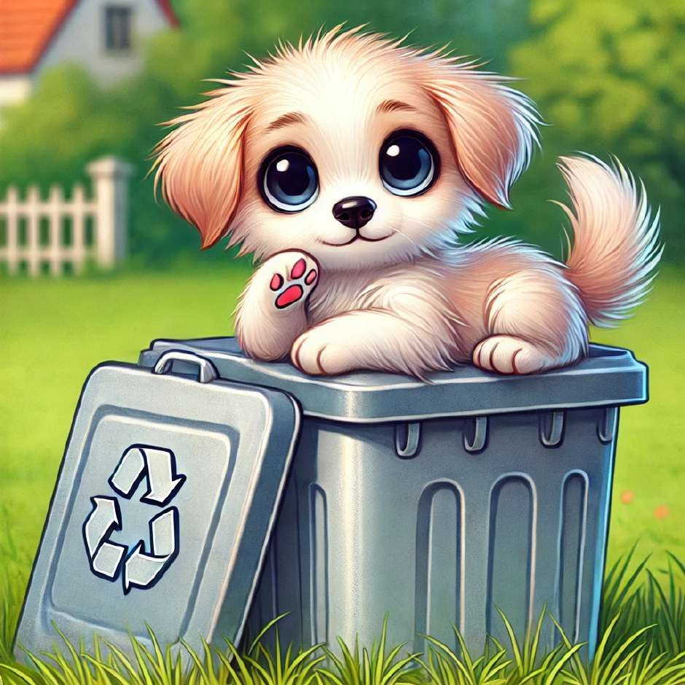
The pet is on.

Slide 7
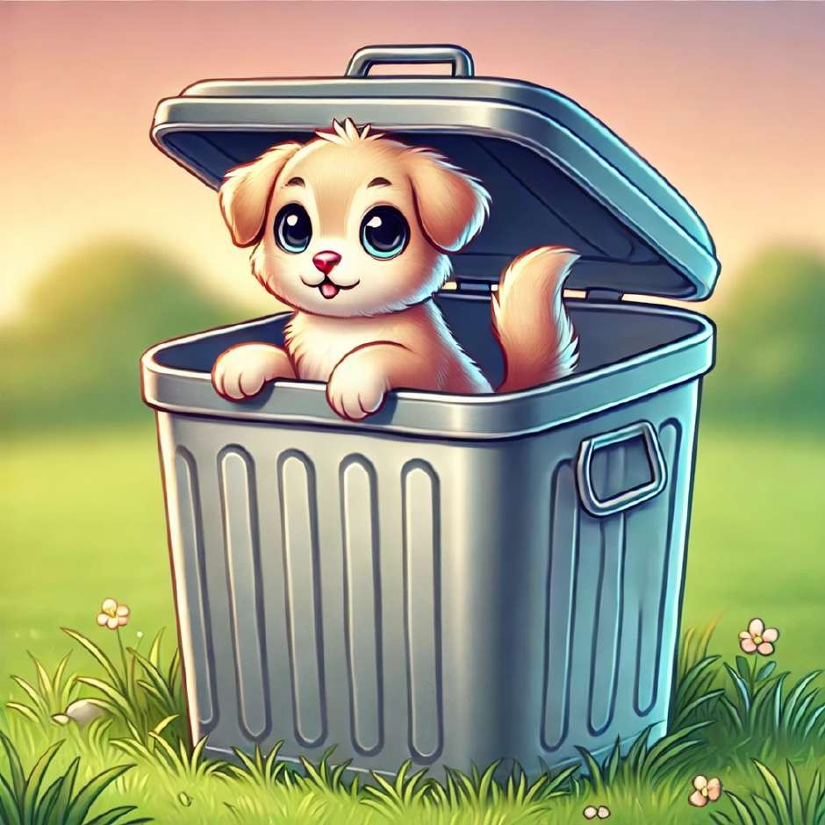
The pet is in.

Slide 8
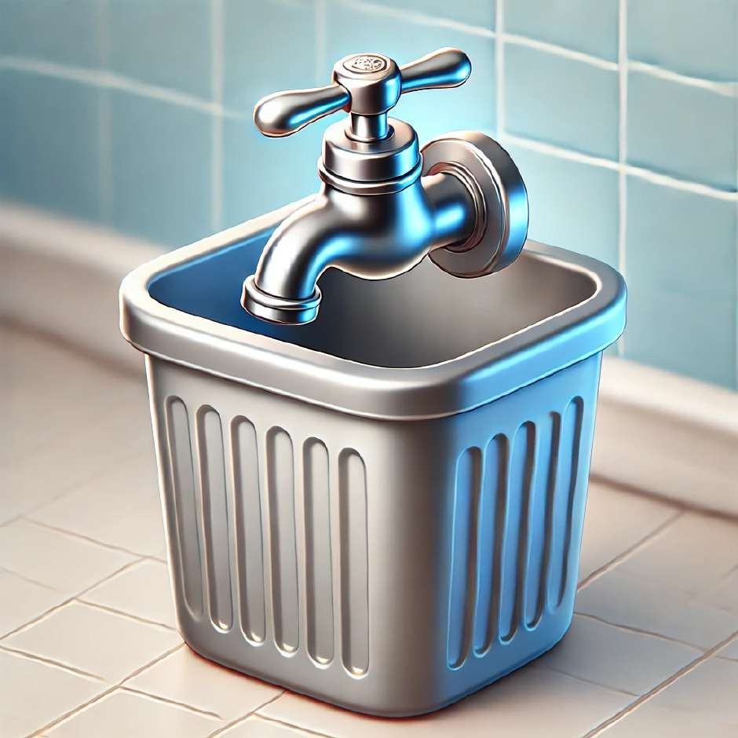
The tap is in the bin.

Slide 9
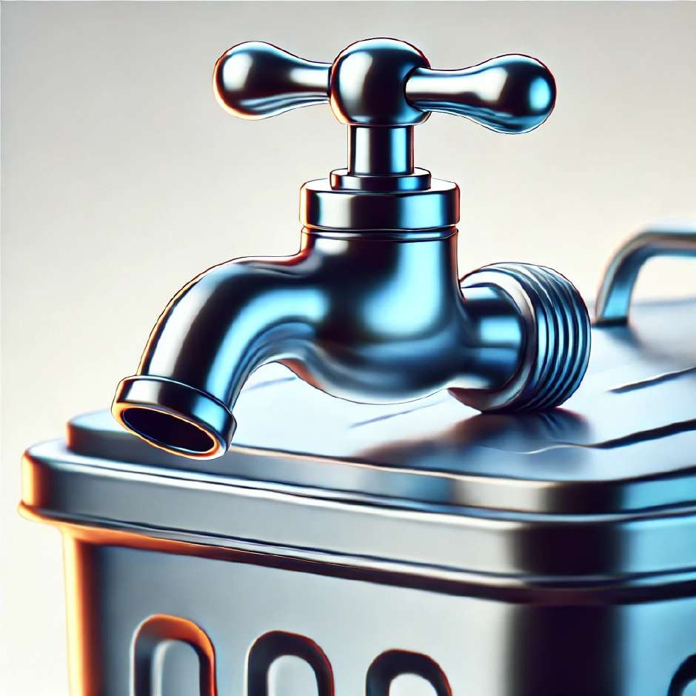
The tap is on.

Slide 10
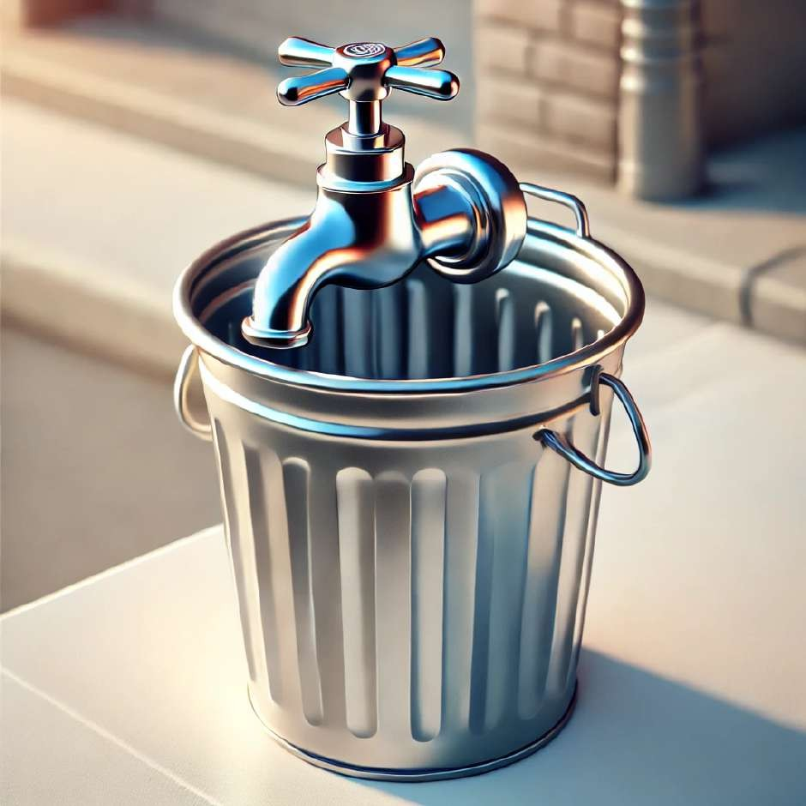
The tap is in.

Slide 11
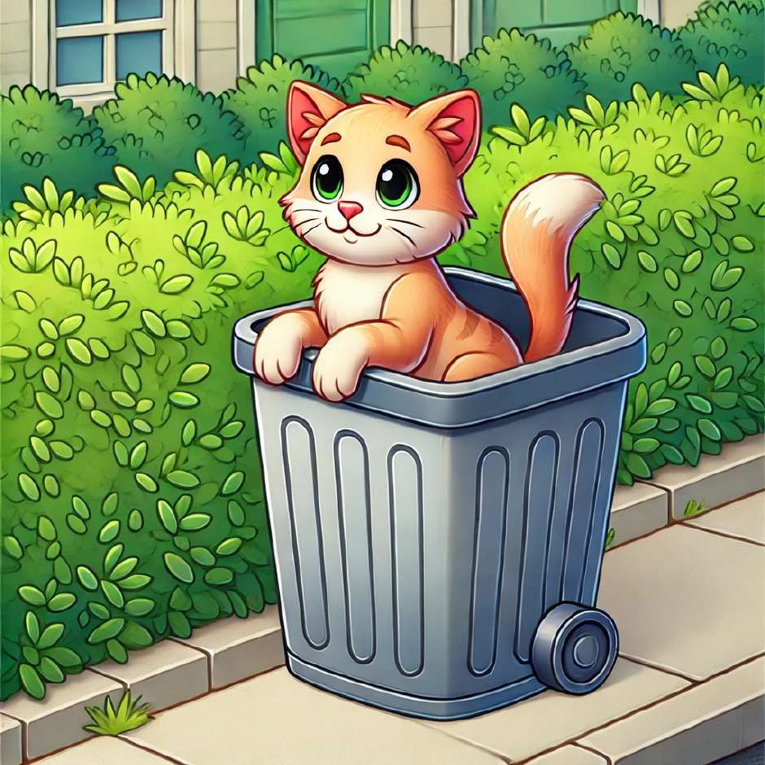
The cat is in the bin.

Slide 12
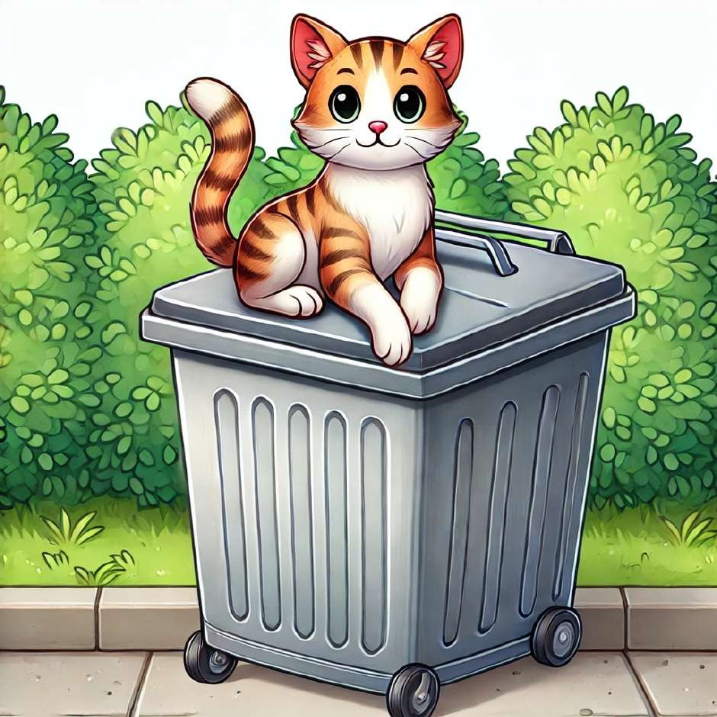
The cat is on.

Slide 13
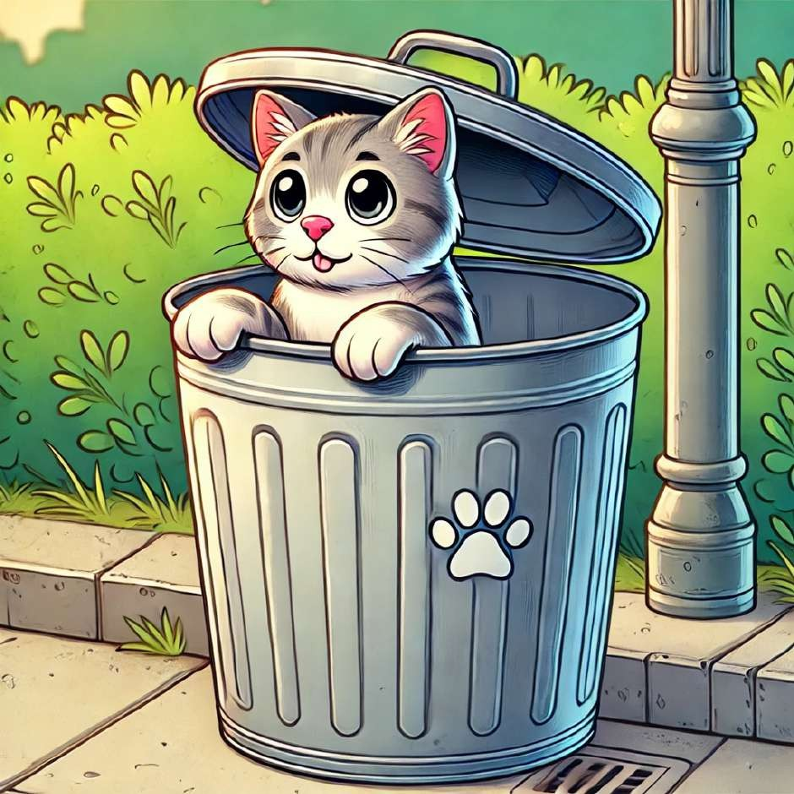
The cat is in.

Slide 14
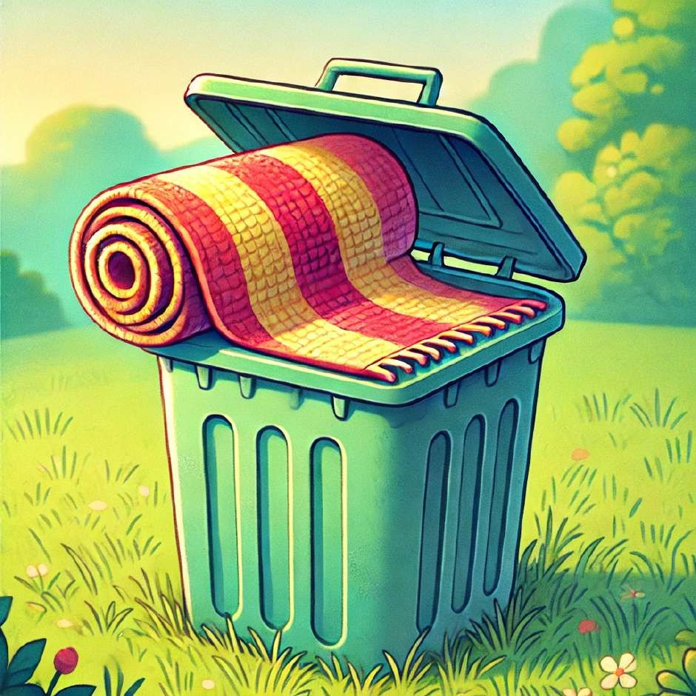
The mat is in the bin.

Slide 15
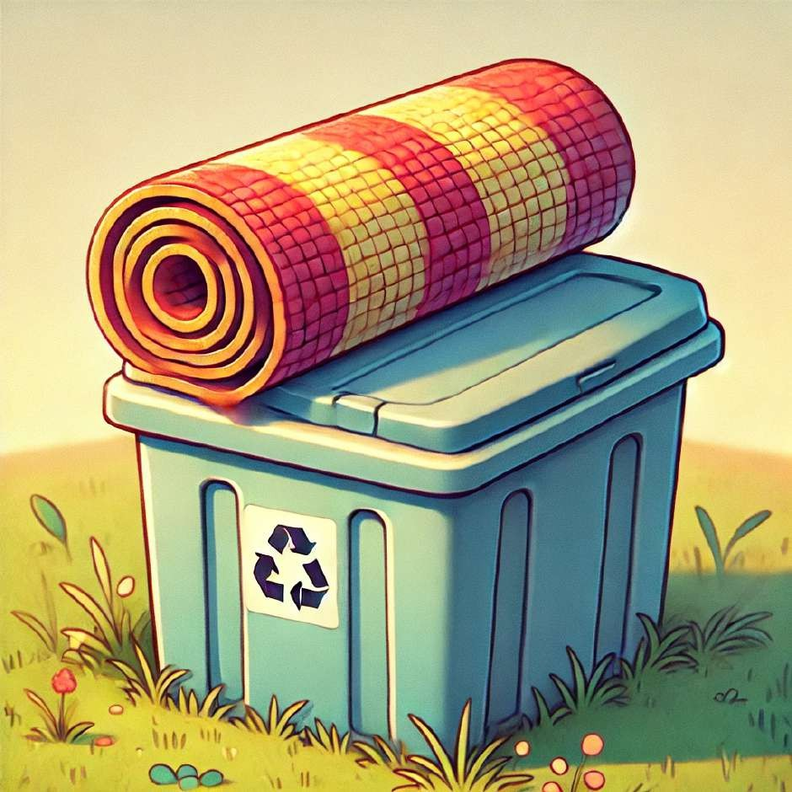
The mat is on.

Slide 16
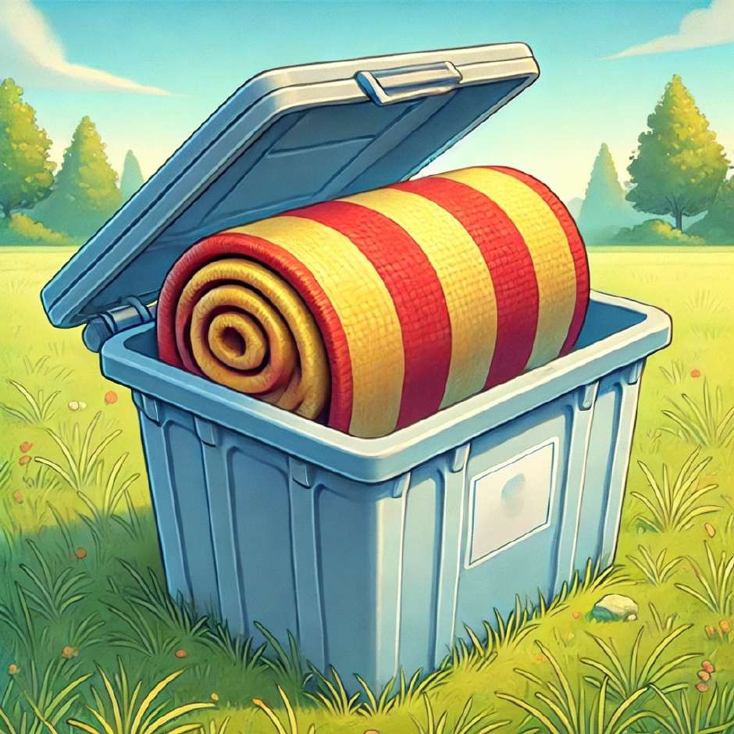
The mat is in.

Slide 17
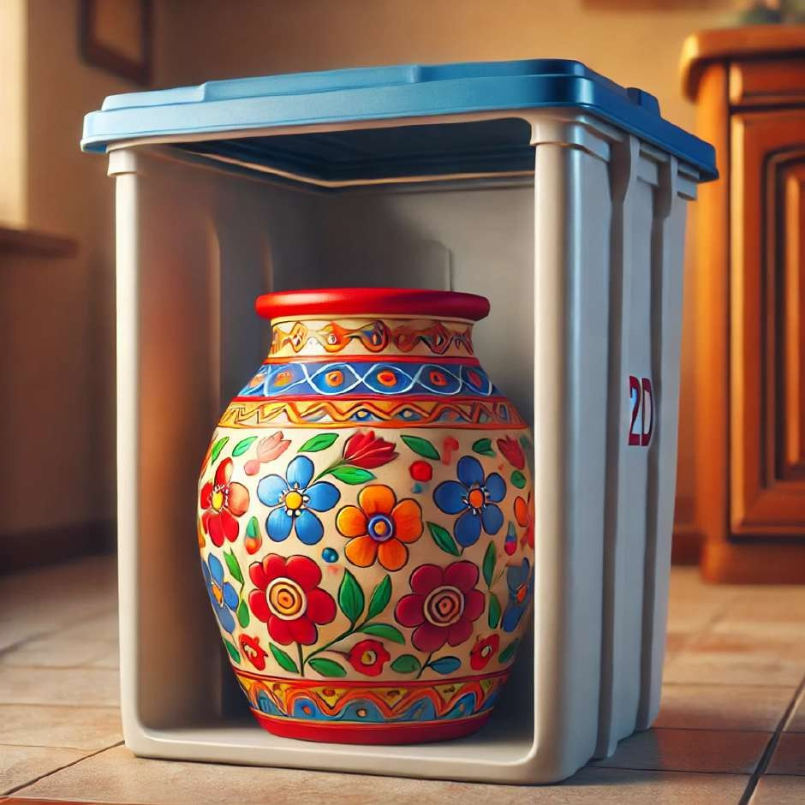
The pot is in the bin.

Slide 18
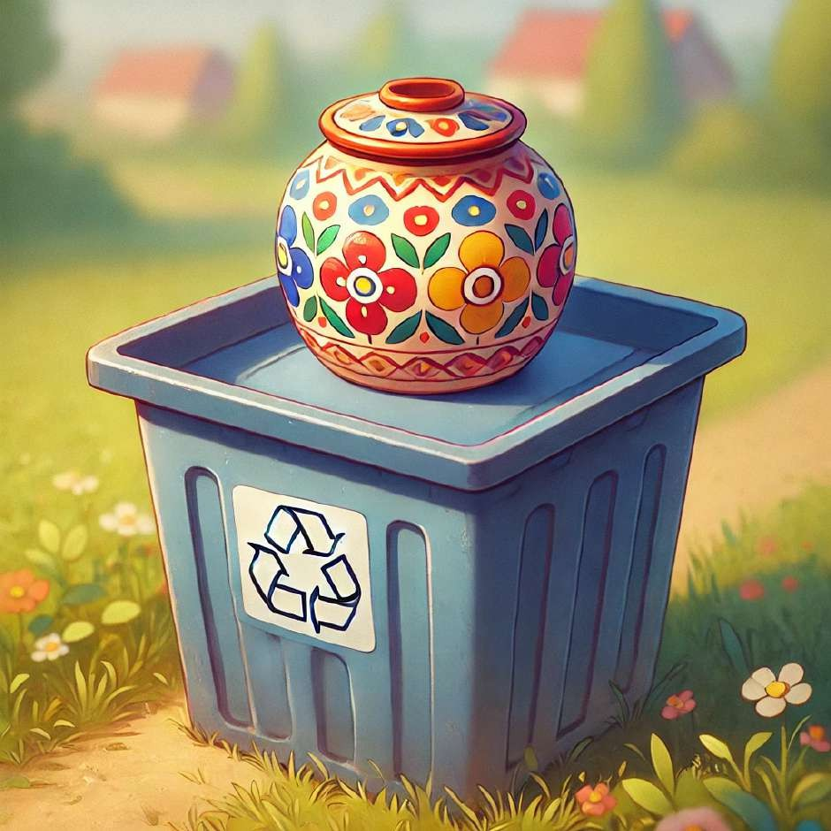
The pot is on.

Slide 19
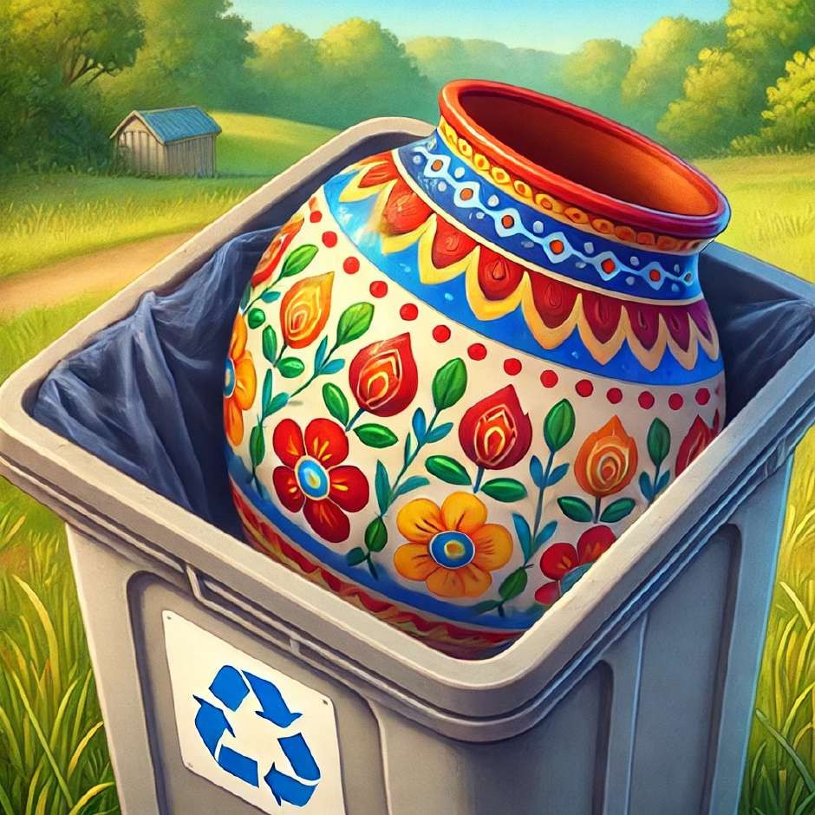
The pot is in.

Slide 20
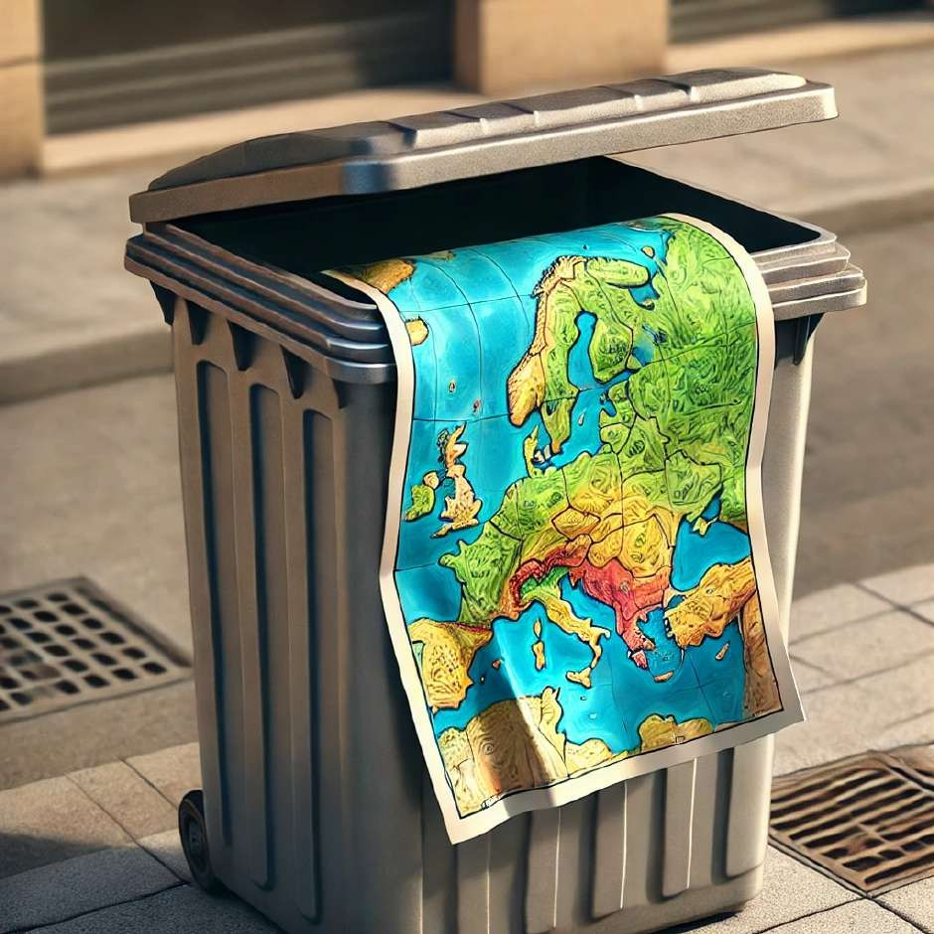
The map is in the bin.

Slide 21
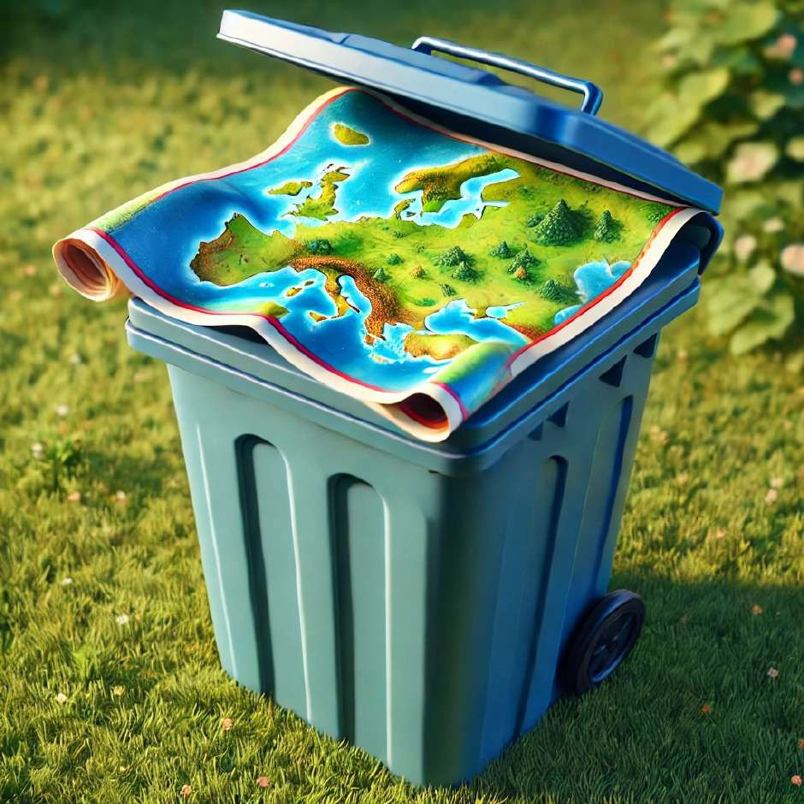
The map is on.

Slide 22
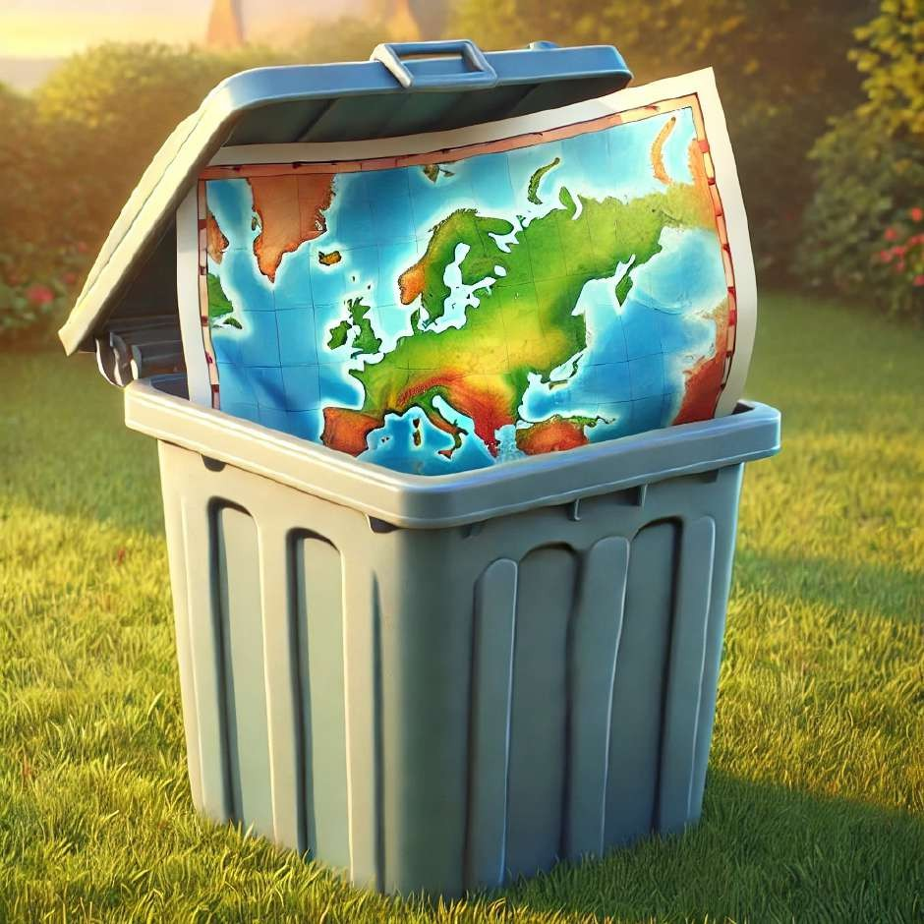
The map is in.

Slide 23
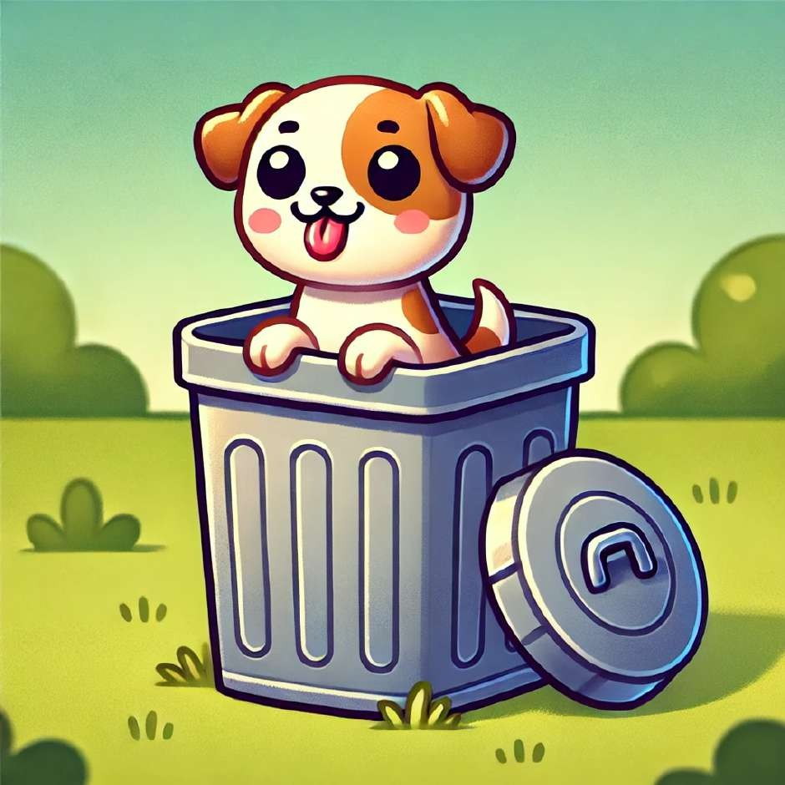
The dog is in the bin.

Slide 24
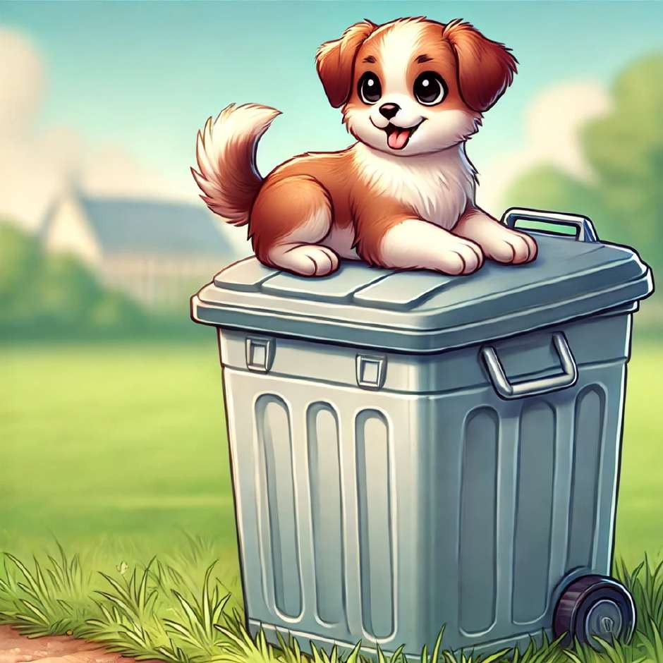
The dog is on.

Slide 25
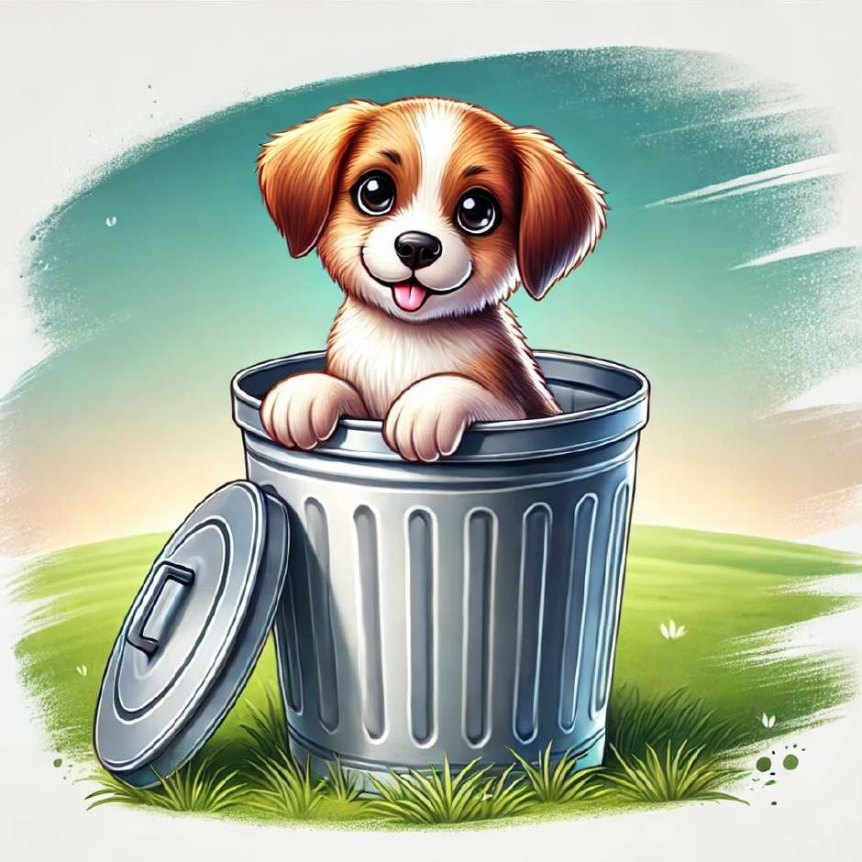
The dog is in.

Slide 26
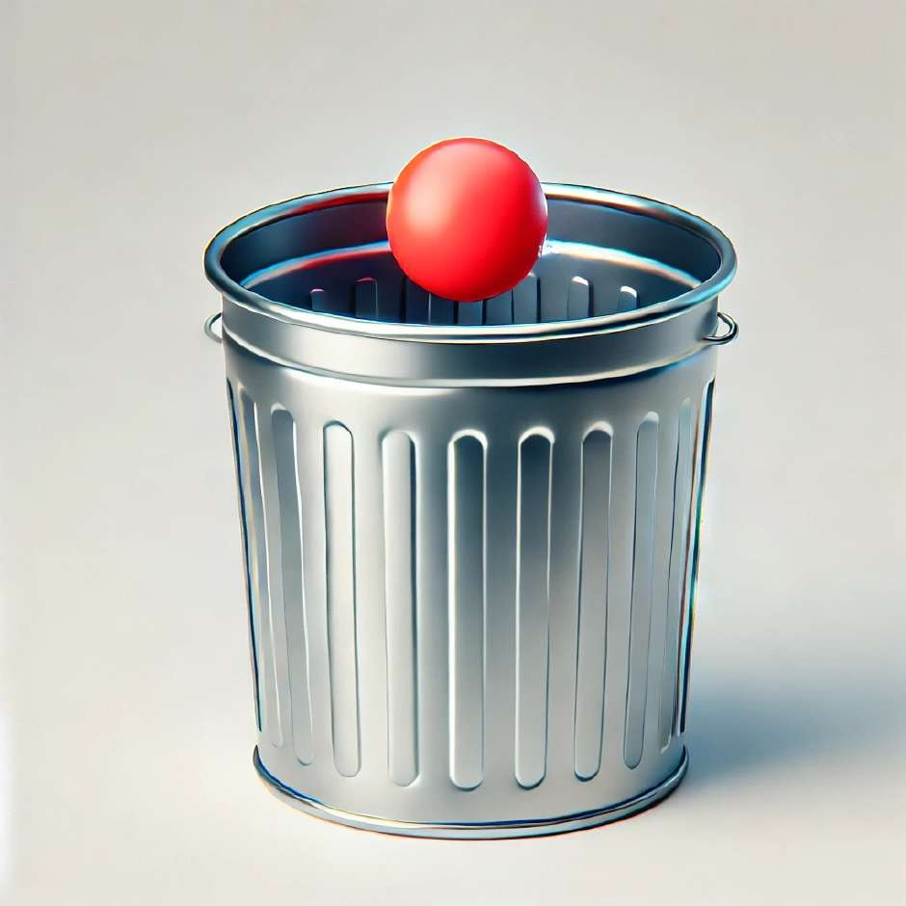
The dot is in the bin.

Slide 27
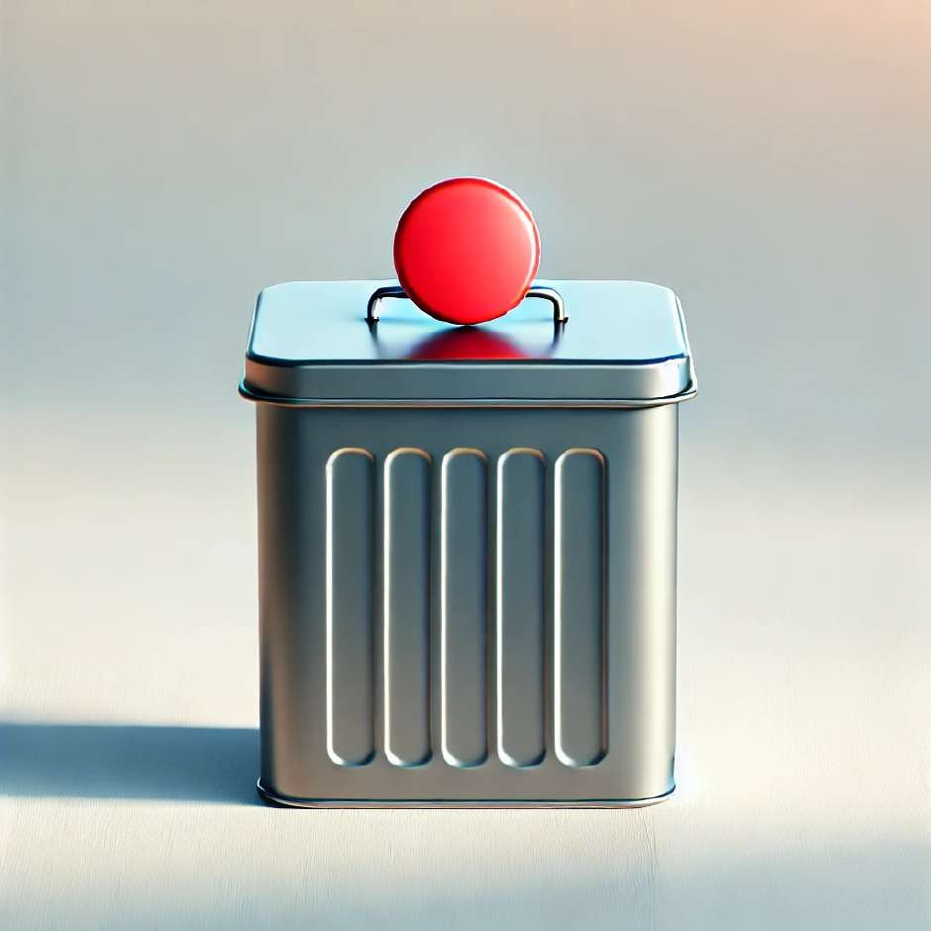
The dot is on.

Slide 28
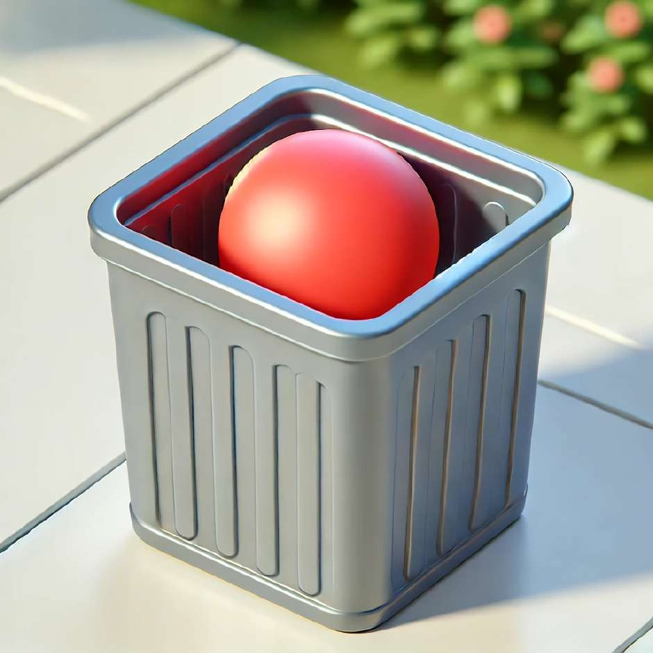
The dot is in.

Slide 29
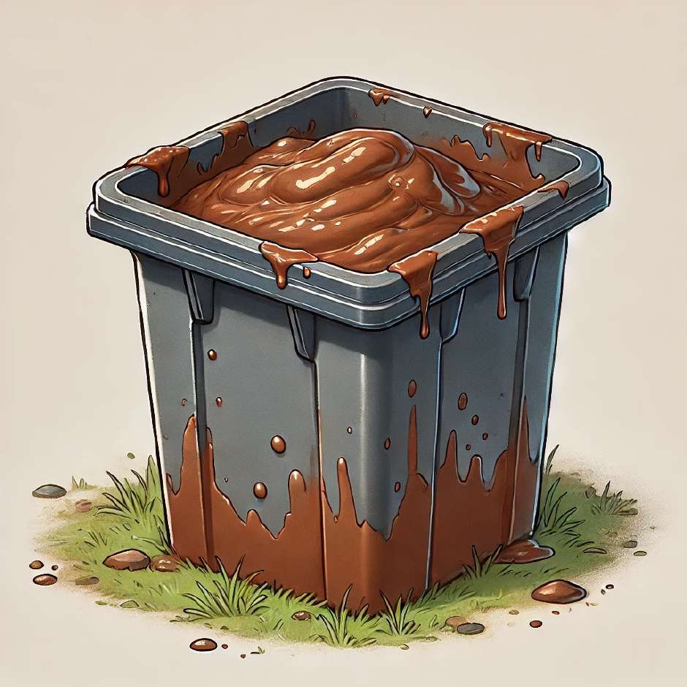
The mud is in the bin.

Slide 30
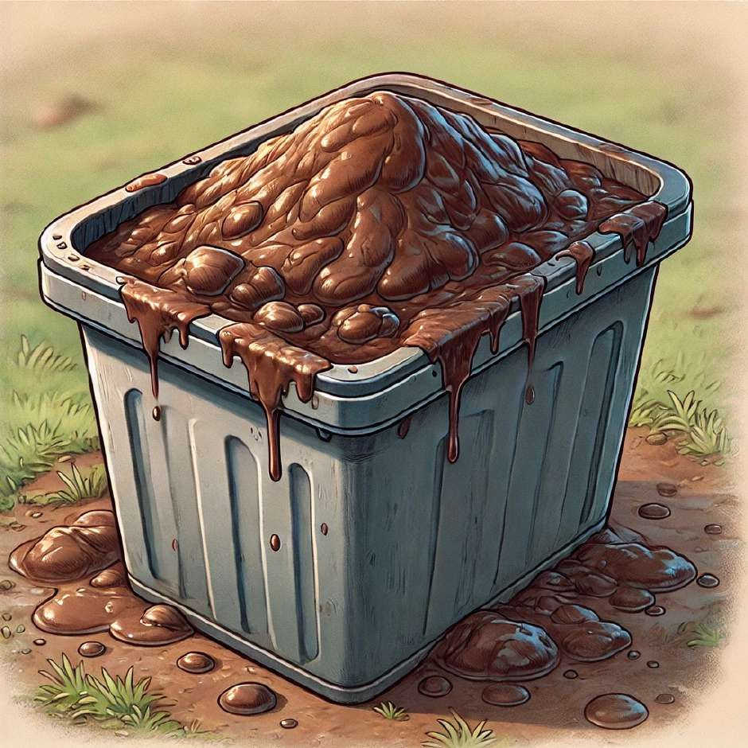
The mud is on.

Slide 31
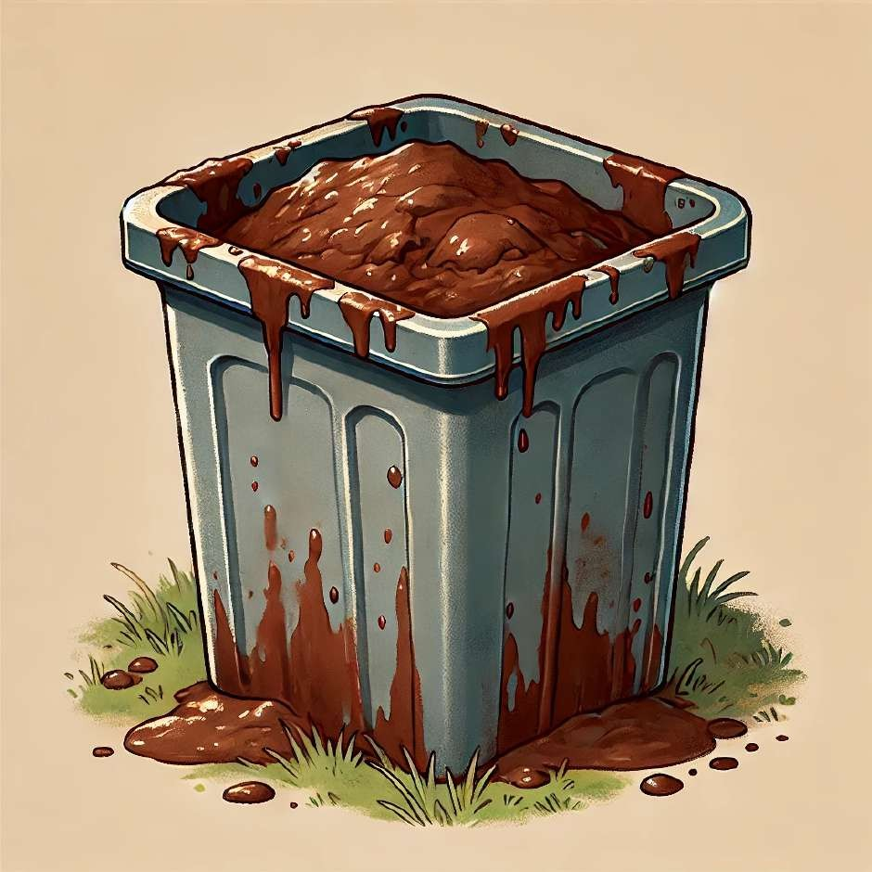
The mud is in.

Slide 32
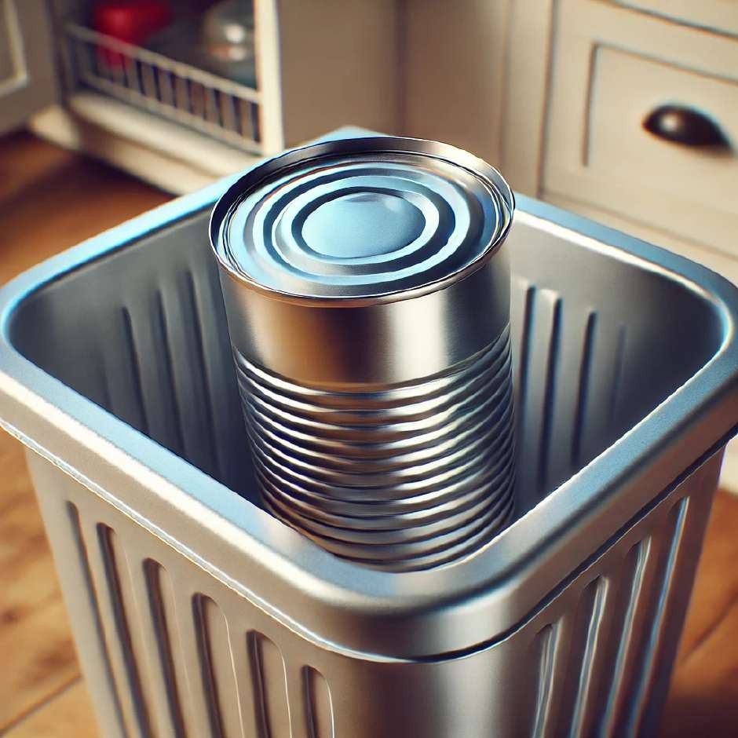
The tin is in the bin.

Slide 33
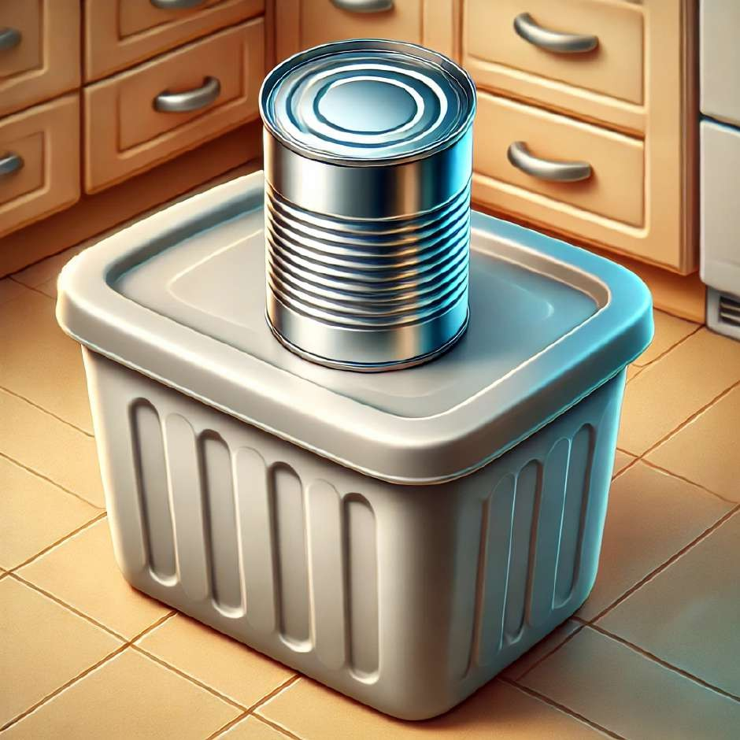
The tin is on.

Slide 34
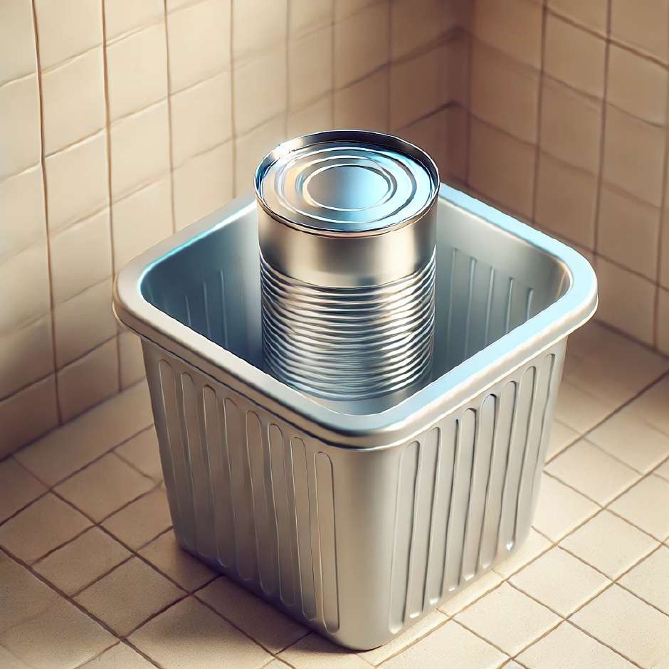
The tin is in.

Slide 35
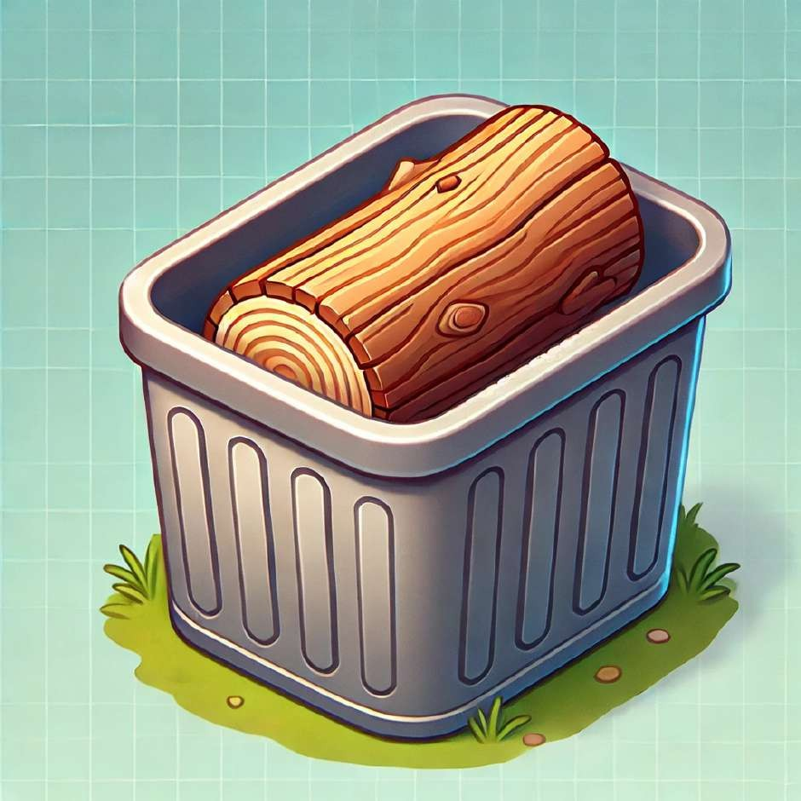
The log is in the bin.

Slide 36
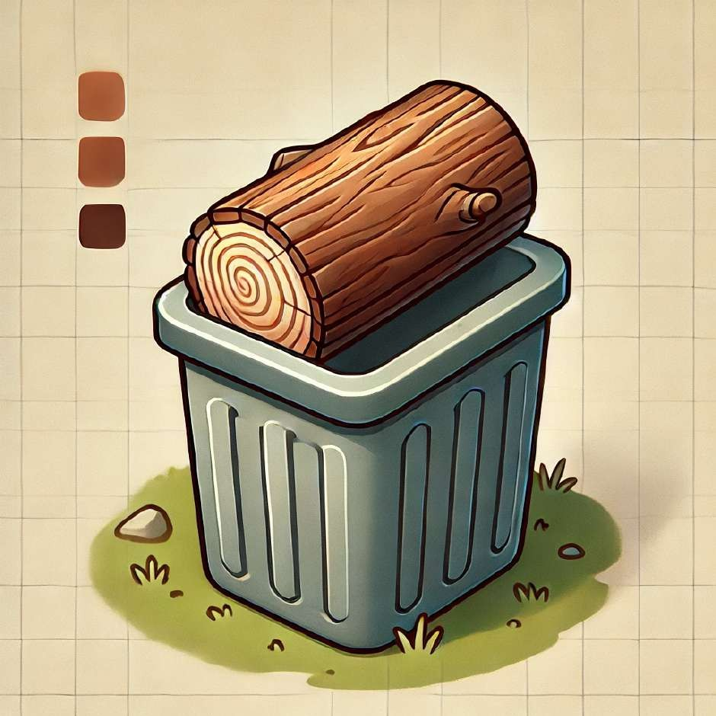
The log is on.

Slide 37
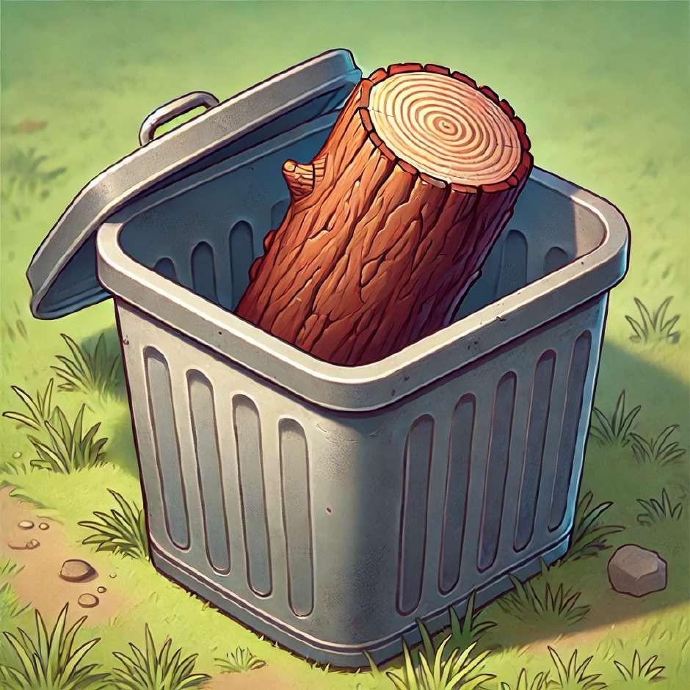
The log is in.

Slide 38
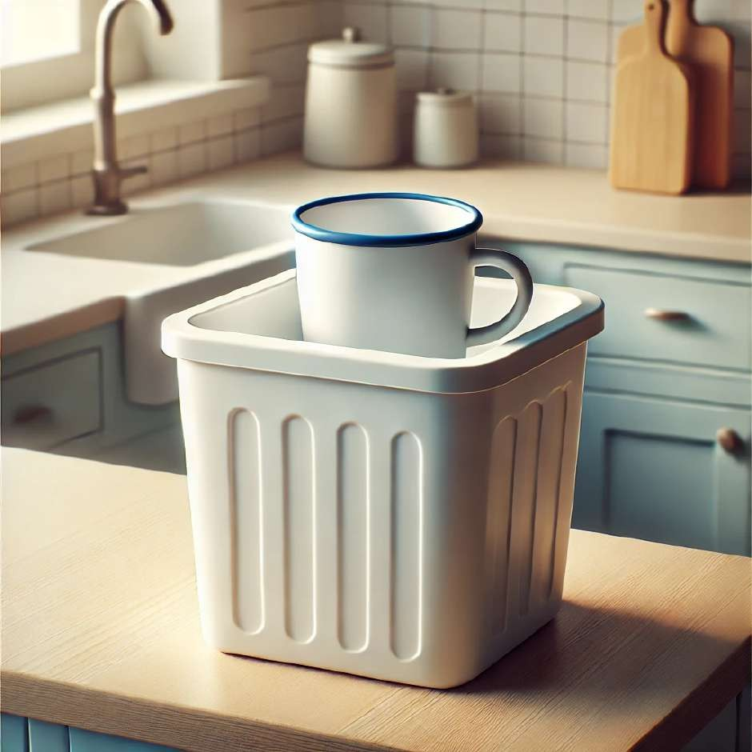
The cup is in the bin.

Slide 39
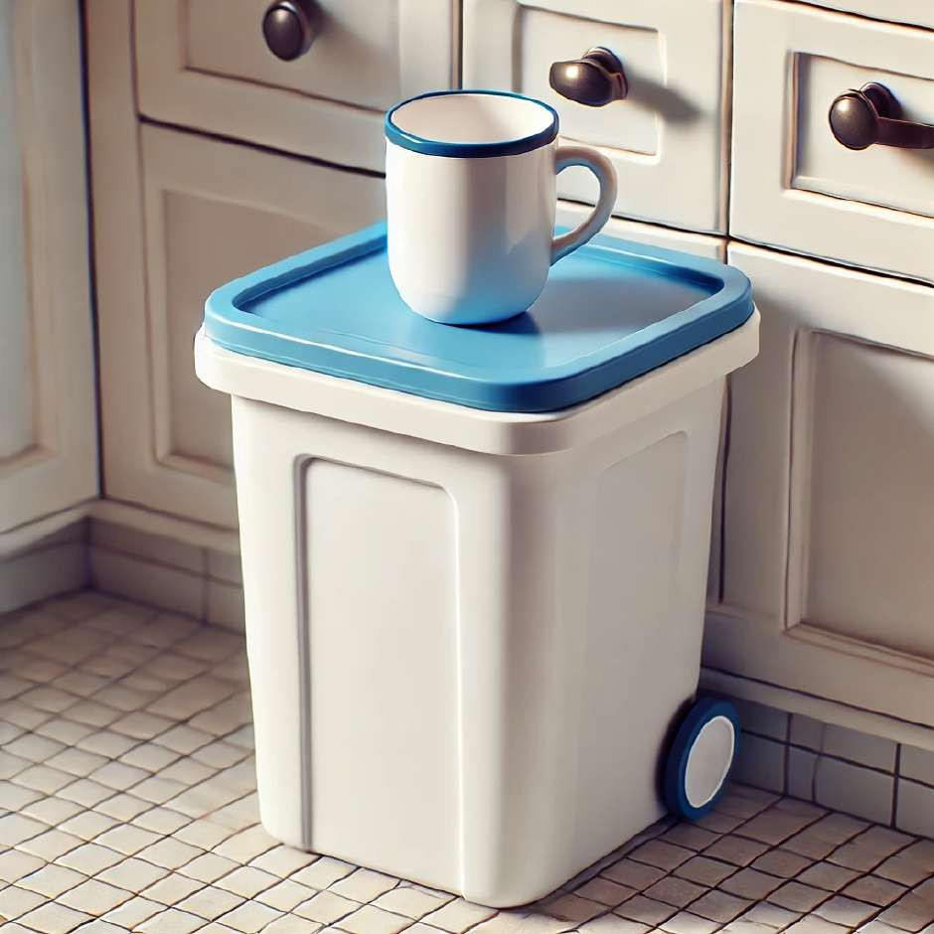
The cup is on.

Slide 40
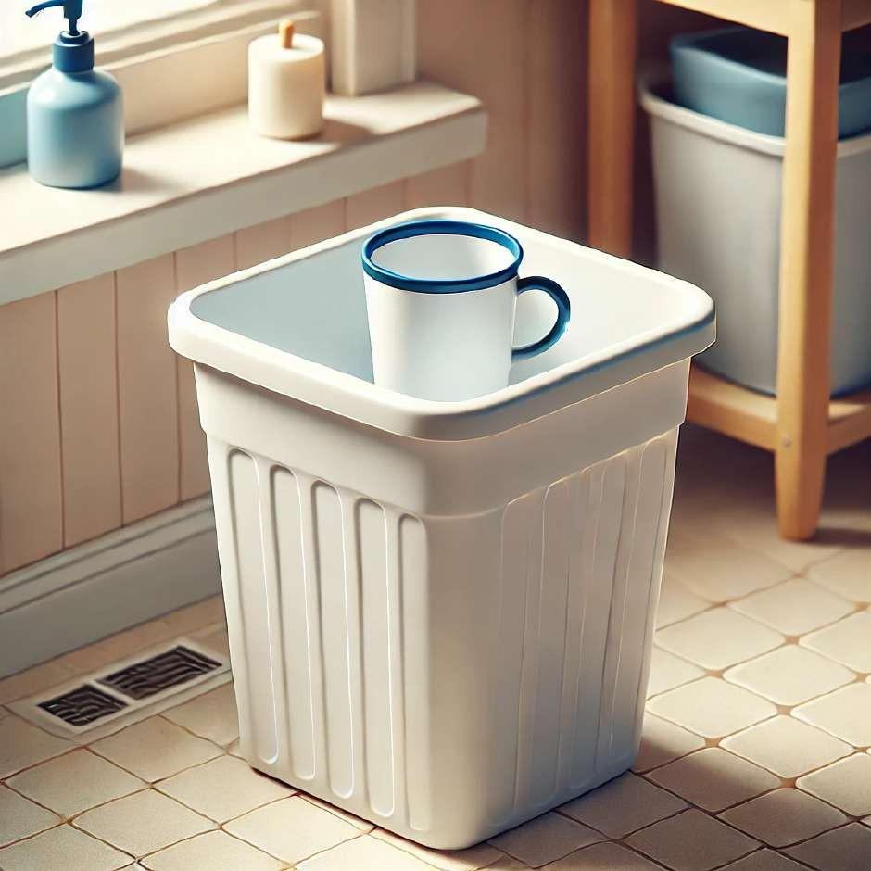
The cup is in.

Slide 41
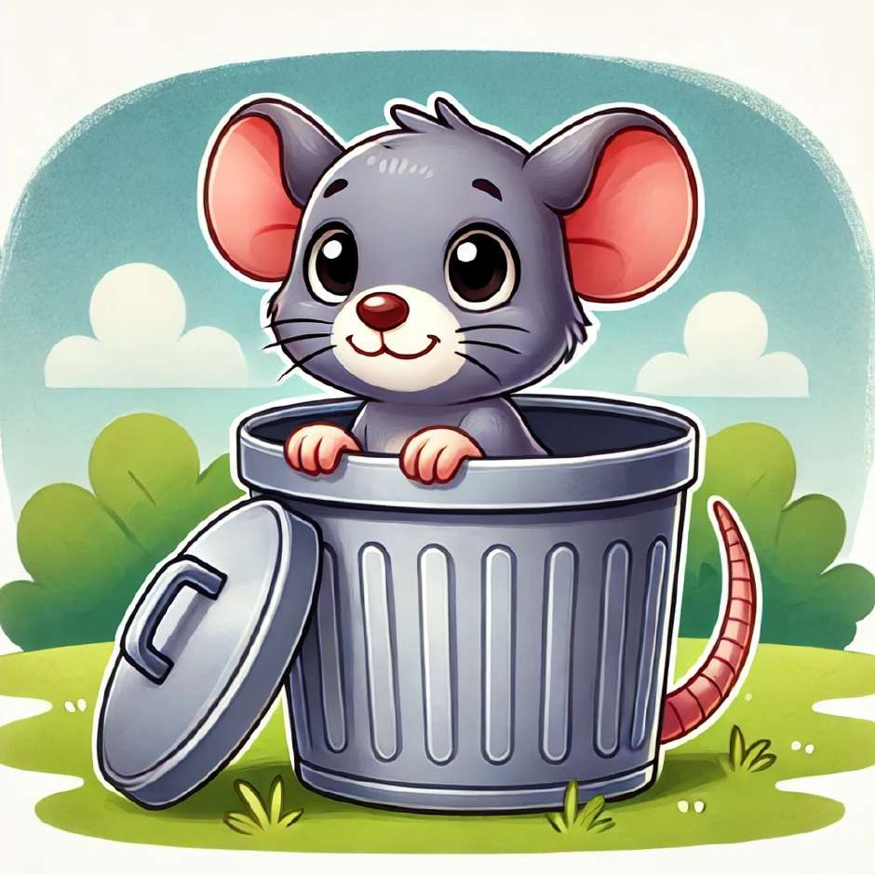
The rat is in the bin.

Slide 42
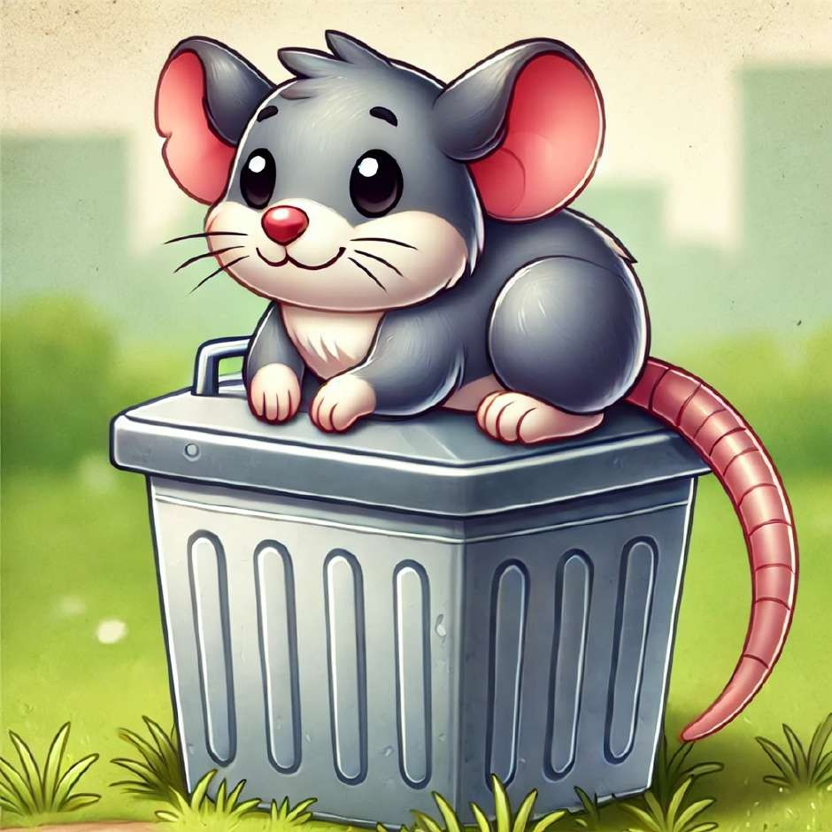
The rat is on.

Slide 43
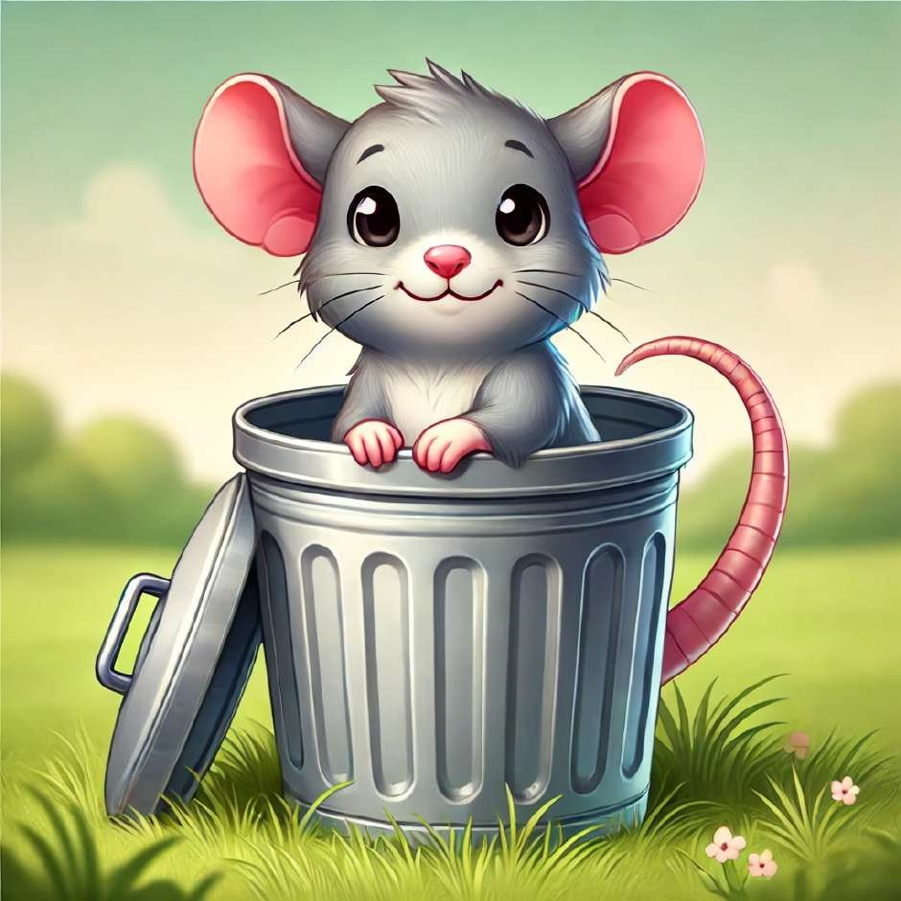
The rat is in.

Slide 44
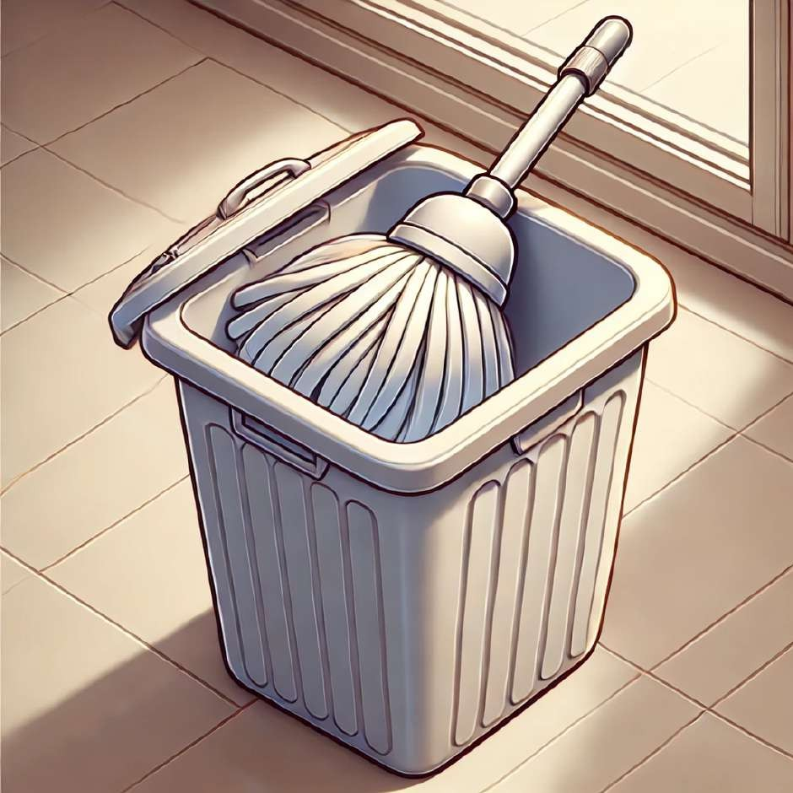
The mop is in the bin.

Slide 45
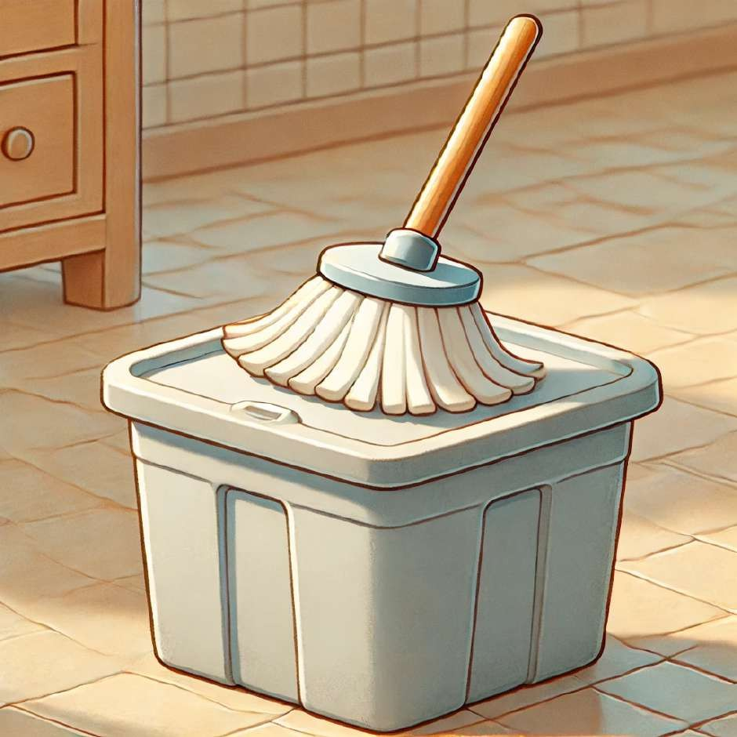
The mop is on.

Slide 46
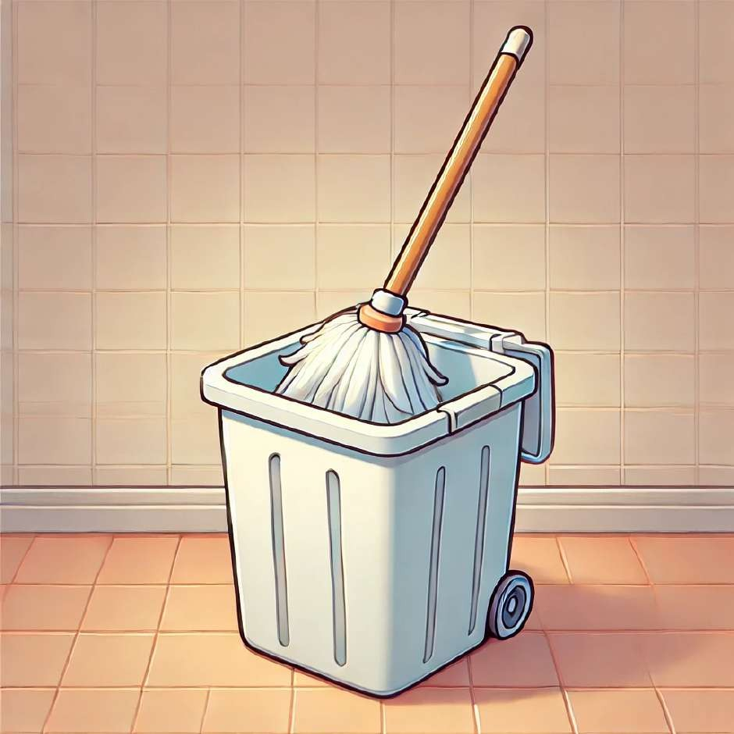
The mop is in.

Slide 47
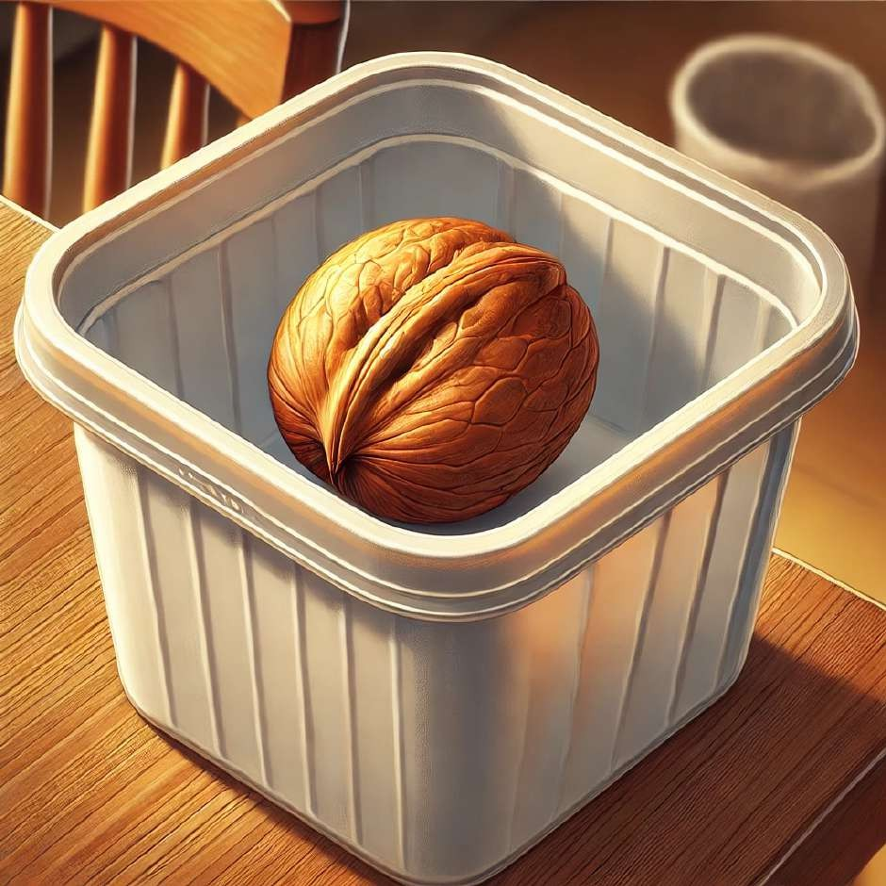
The nut is in the bin.

Slide 48
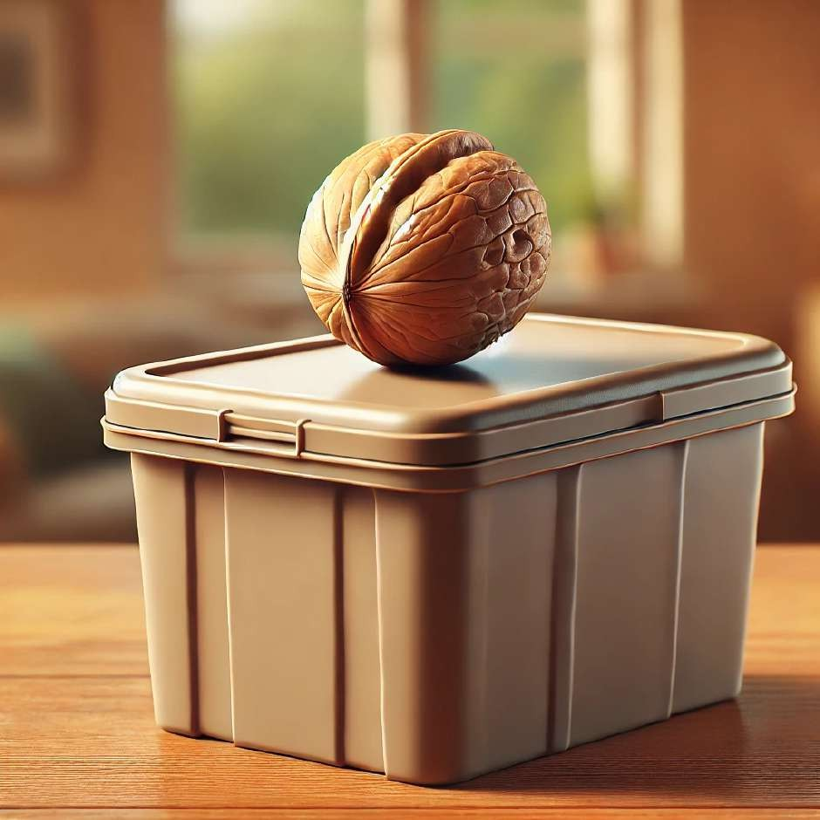
The nut is on.

Slide 49
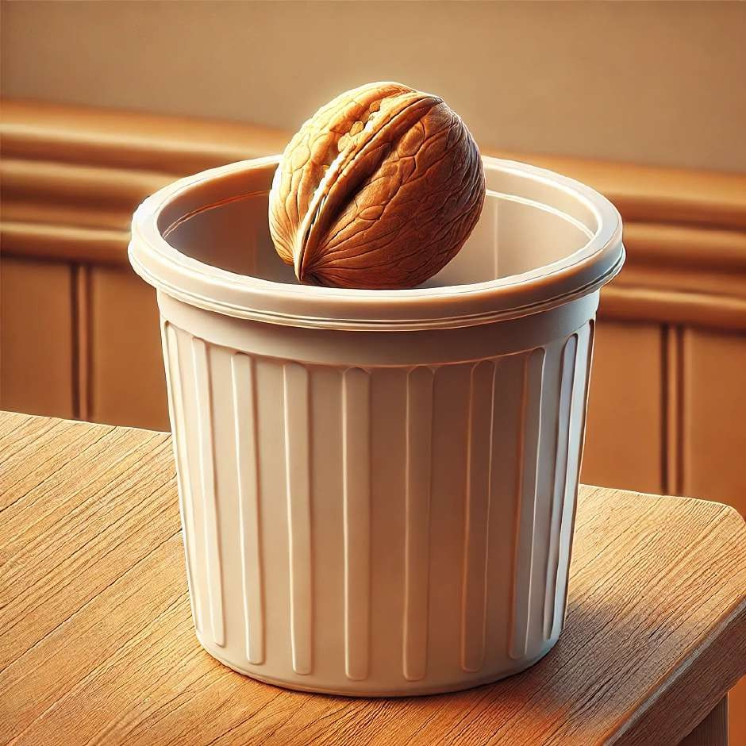
The nut is in.

Slide 50
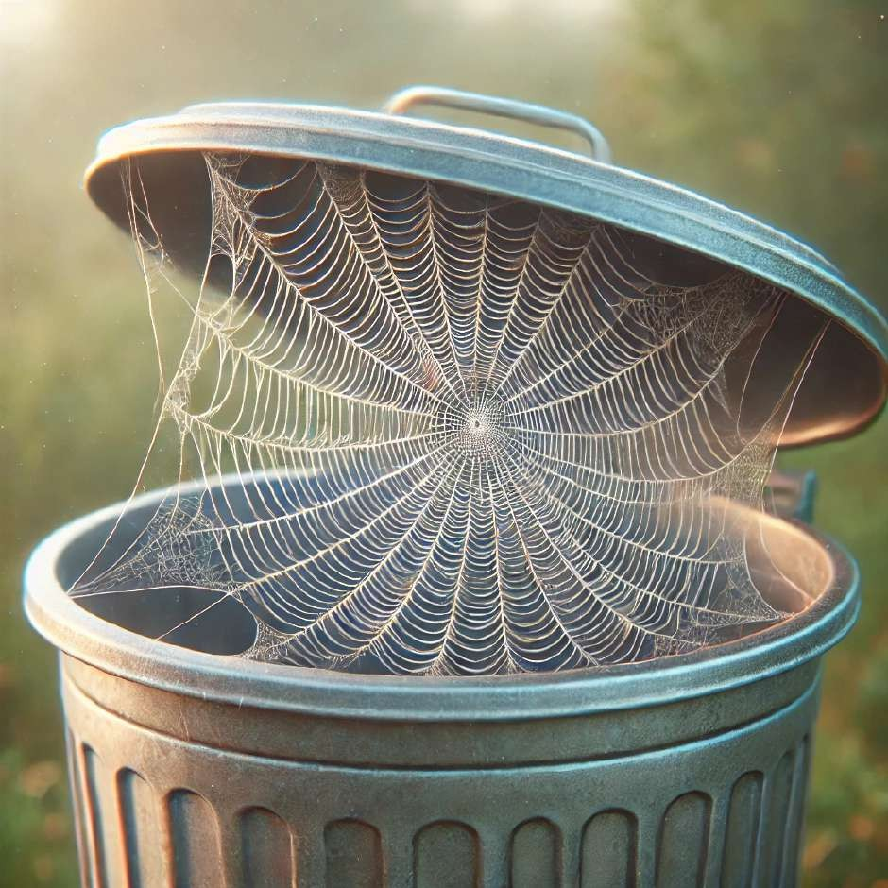
The web is in the bin.

Slide 51
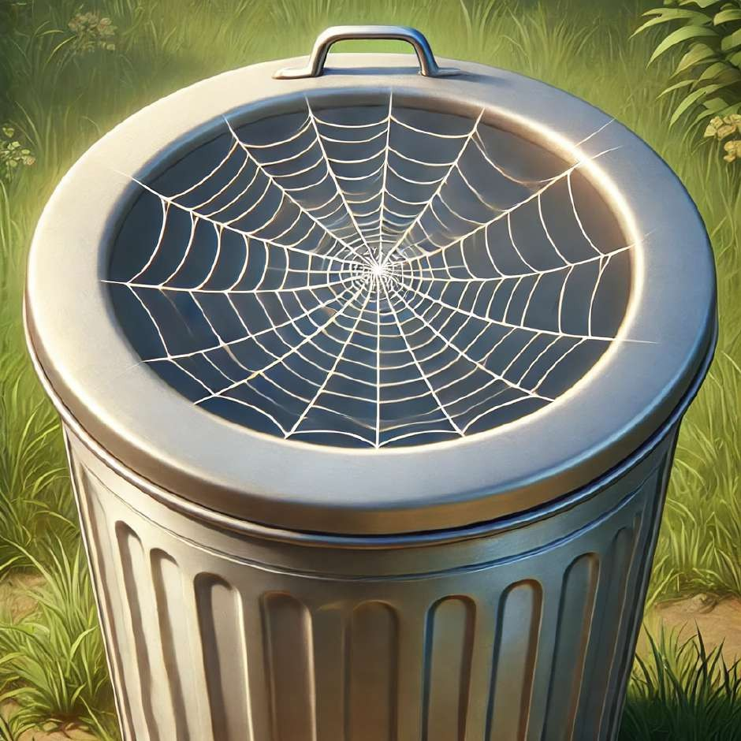
The web is on.

Slide 52

The web is in.

Slide 53

The hen is in the bin.

Slide 54

The hen is on.

Slide 55

The hen is in.

Slide 56

The bed is in the bin.

Slide 57

The bed is on.

Slide 58

The bed is in.

Slide 59

The bag is in the bin.

Slide 60

The bag is on.

Slide 61

The bag is in.

Slide 62

The van is in the bin.

Slide 63

The van is on.

Slide 64

The van is in.

Slide 65

The bus is in the bin.

Slide 66

The bus is on.

Slide 67

The bus is in.

Slide 68

The pig is in the bin.

Slide 69

The pig is on.

Slide 70

The pig is in.

Slide 71
Reference
OpenAI. (2025). SET 1 design concept [AI-generated image]. DALL·E. Retrieved from [OpenAI Platform] https://chatgpt.com/c/6758dd08-22e0-8005-8145- 9e9ed9217e16
OpenAI. (2025). SET 1: An educational design with vibrant geometric patterns
[AI-generated image]. https://www.meta.ai/

